Slide 1
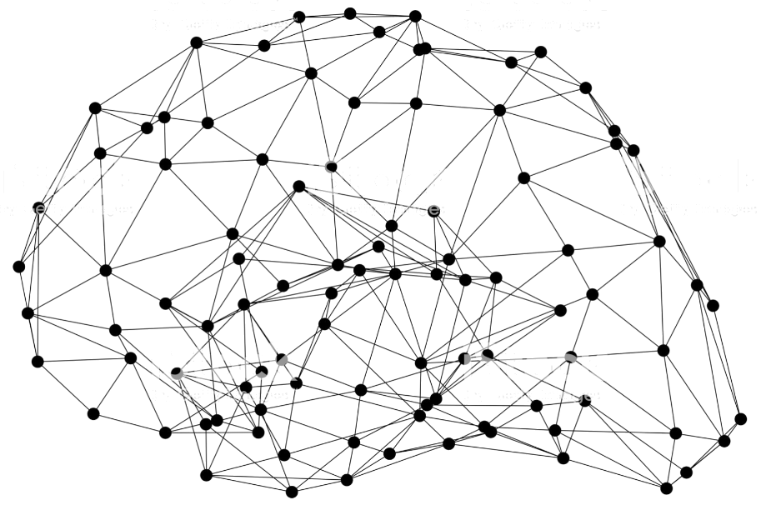
AWS | Artificial Intelligence
Centerpiece for digital transformation
Dylan Tong, AI/Machine Learning Partner Solutions Architect
Notes:
First call deck for CXO level introduction to Amazon AI.

Slide 2
What is AI?

Slide 3
Reinventing the Retail Experience

Slide 4
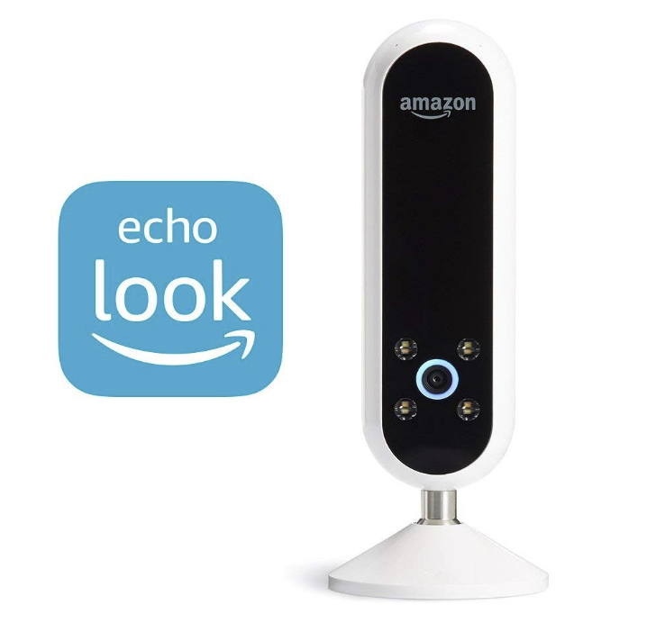

AI Driven Stylist

Slide 5
Smart Factory
Inspection:
Granular Quality and Progress Tracking
Asset Tracing
(SKU)

Slide 6

The Connected Worker
WORKER SAFETY
COMPLIANT
WORKER TRACKING
JOHN
DAVE

Slide 7
The Connected Worker
Improve worker productivity through new digital experiences:
Voice-enabled Interfaces
Augmented Reality
Reduce key-strokes and lower the learning curve of complex machinery.

Slide 8
Smart Machine Era:
Reduces 90% use of herbicide through Blue River’s smart sprayer. Computer Vision technology built on AWS and NVIDA GPU.

Slide 9

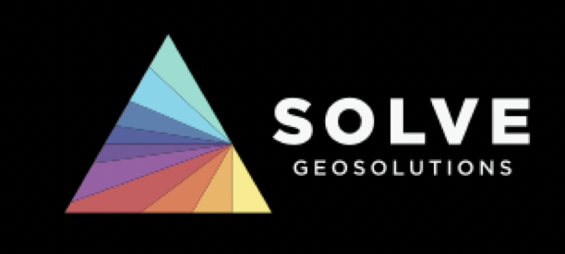
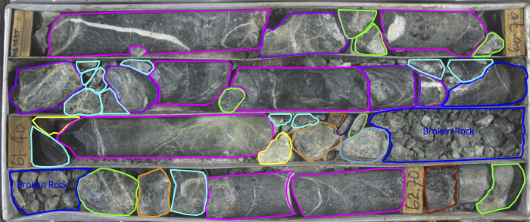
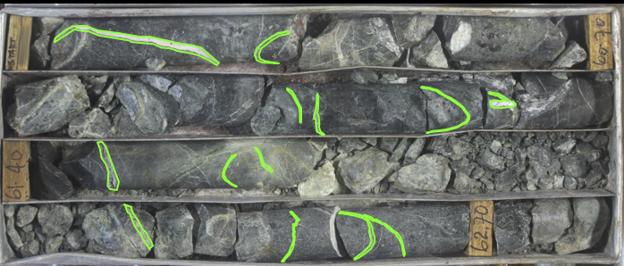
Notes:
Fragment segmentation- quality assessment. Risk of faults
Vein segmentation- precious metal exploration opportunities

Slide 10
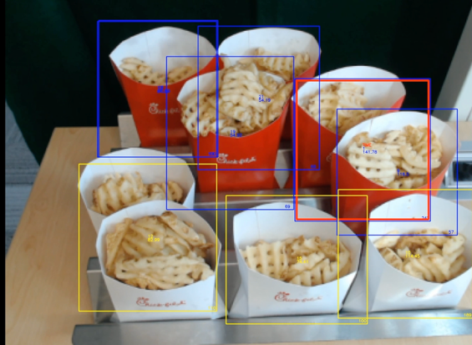

Slide 11

Mission: to put machine learning in the hands of every developer.
Technology
Notes:
On the technology side, ML should increasingly be integrated into just about every aspect of your business.
To do so, requires a new stack that is tailored to the unique needs of your business.

Slide 12









The Amazon ML stack: Broadest & deepest set of capabilities
Vision
Speech
Language
Chatbots
Forecasting
Recommendations
AI SERVICES
REKOGNITION
IMAGE
REKOGNITION
VIDEO
TEXTRACT
POLLY
TRANSCRIBE
TRANSLATE
COMPREHEND
LEX
FORECAST
PERSONALIZE
AMAZON SAGEMAKER
ML SERVICES
BUILD
TRAIN
DEPLOY
Pre-built algorithms & notebooks
One-click model training & tuning
One-click deployment & hosting
Data labeling (GROUND TRUTH)
Optimization (NEO)
Algorithms & models (AWS MARKETPLACE
FOR MACHINE LEARNING)
Reinforcement learning
Frameworks
Interfaces
Infrastructure
ML FRAMEWORKS & INFRASTRUCTURE
EC2 P3 & P3N
EC2 C5
FPGAs
GREENGRASS
ELASTIC INFERENCE
Notes:
We see the Machine Learning stack having three key layers.
ML Frameworks:
The bottom layer is for expert machine learning practitioners—researchers and developers.
These are people who are comfortable building models, tuning models, training models, figuring out how to deploy into production, and manage them themselves.
And the vast majority of machine learning in the cloud today at this layer is being down through Amazon SageMaker which provides a managed experience for frameworks, or the AWS Deep Learning AMI that we built that effectively embeds all the major frameworks.
Infrastructure:
AWS offers a broad array of compute options for training and inference with powerful GPU-based instances, compute and memory optimized instances, and even FPGAs.
Our P3 instances provide up to 14 times better performance than previous-generation Amazon EC2 GPU compute instances.
C5 instances offer higher memory to vCPU ratio and deliver 25% improvement in price/performance compared to C4 instances, and are ideal for demanding inference applications.
We also have Amazon EC2 F1, a compute instance with field programmable gate arrays (FPGAs) that you can program to create custom hardware accelerations for your machine learning applications. F1 instances are easy to program and come with everything you need to develop, simulate, debug, and compile your hardware acceleration code. You can reuse your designs as many times, and across as many F1 instances as you like.
The new Amazon EC2 P3dn instance has four-times the networking bandwidth and twice the GPU memory of the largest P3 instance, P3dn is ideal for large scale distributed training. No one else has anything close.
P3dn.24xlarge instances offer 96vCPUs of Intel Skylake processors to reduce preprocessing time of data required for machine learning training.
The enhanced networking of the P3n instance allows GPUs to be used more efficiently in multi-node configurations so training jobs complete faster.
Finally, the extra GPU memory allows developers to easily handle more advanced machine learning models such as holding and processing multiple batches of 4k images for image classification and object detection systems
ML Services:
But, if you want to enable most enterprises and companies to be able to scale machine learning, we’ve solved that problem for organizations by making ML accessible for everyday developers and scientists. Amazon SageMaker removes the heavy lifting, complexity, and guesswork from each step of the machine learning process.
SageMaker makes model building and training easier by providing pre-built development notebooks, popular machine learning algorithms optimized for petabyte-scale datasets, and automatic model tuning, enabling developers to build, train, and deploy models in a single click.
SageMaker is already helping thousands of developers easily get started with building, training, and deploying models.
AI Services:
At the top layer are AI services which are ready-made for all developers—no ML skills.
For example, customers say here is an object, tell me what's in it, or here's a face, tell me if it's part of this facial group using Amazon Rekognition
Or let me translate text to speech using Amazon Polly
Or let’s build conversational apps with Amazon Lex.
Convert speech to text with Amazon Transcribe
Translate text between languages using Amazon Translate
Understand relationships and find insights from unstructured text using Amazon Comprehend

Slide 13
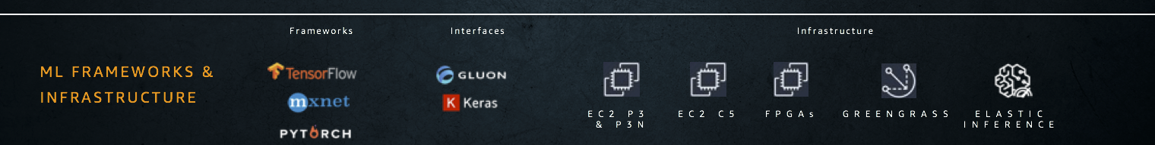
The Amazon ML stack: Frameworks and Infrastructure

Slide 14
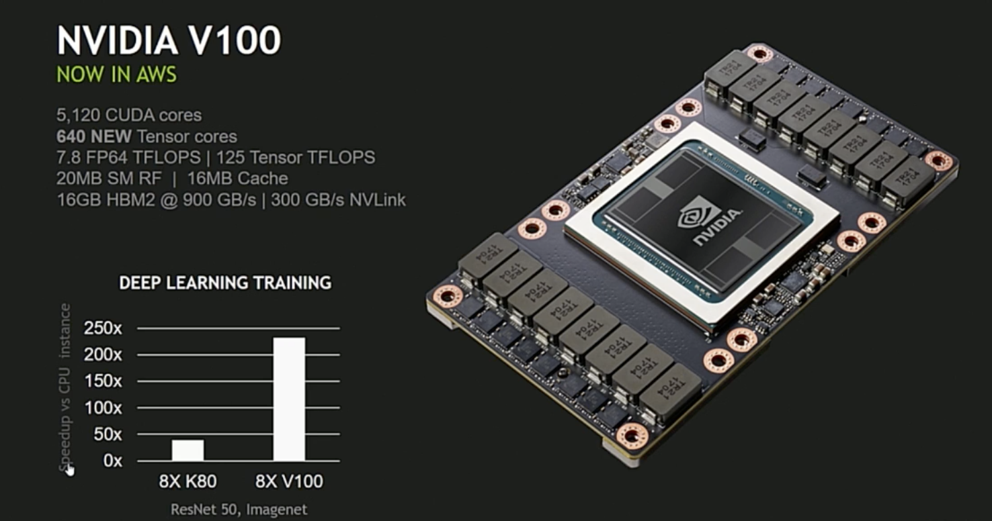
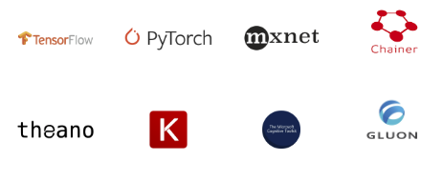
ML Optimized Environments and Infrastructure
More data science, less setup
Deep Learning AMI
Notes:
First in the world to offer the V100s
2-14X increase in performance over various benchmarks compared to previous NVIDIA architecture
Allows you to iterate 200 times more before you go into development in comparison to running on CPU
Imagine the implications it has on the quality of your applications.

Slide 15
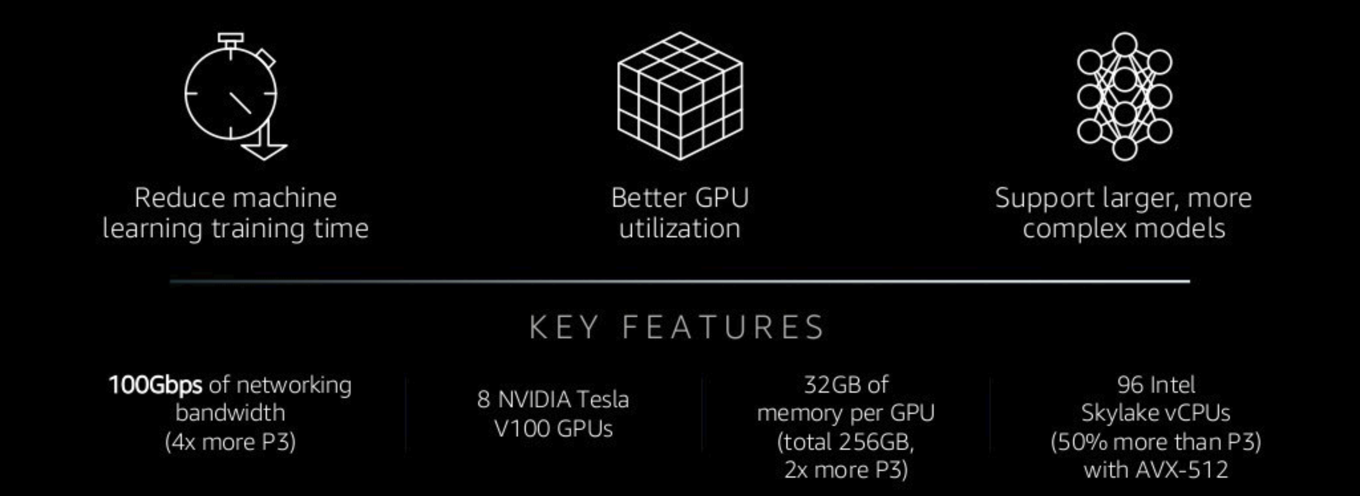
P3dn Instances: Optimized for Training at Scale
Notes:
- Resnet-50 benchmark. Trained on ImageNet database in under 75secs using 2048 V100 GPUs. Made possible with distributed training.
It would take days on a single GPU machine.
Network is the bottleneck in distributed training. A lot of data needs to be exchanged across servers in the cluster.

Slide 16
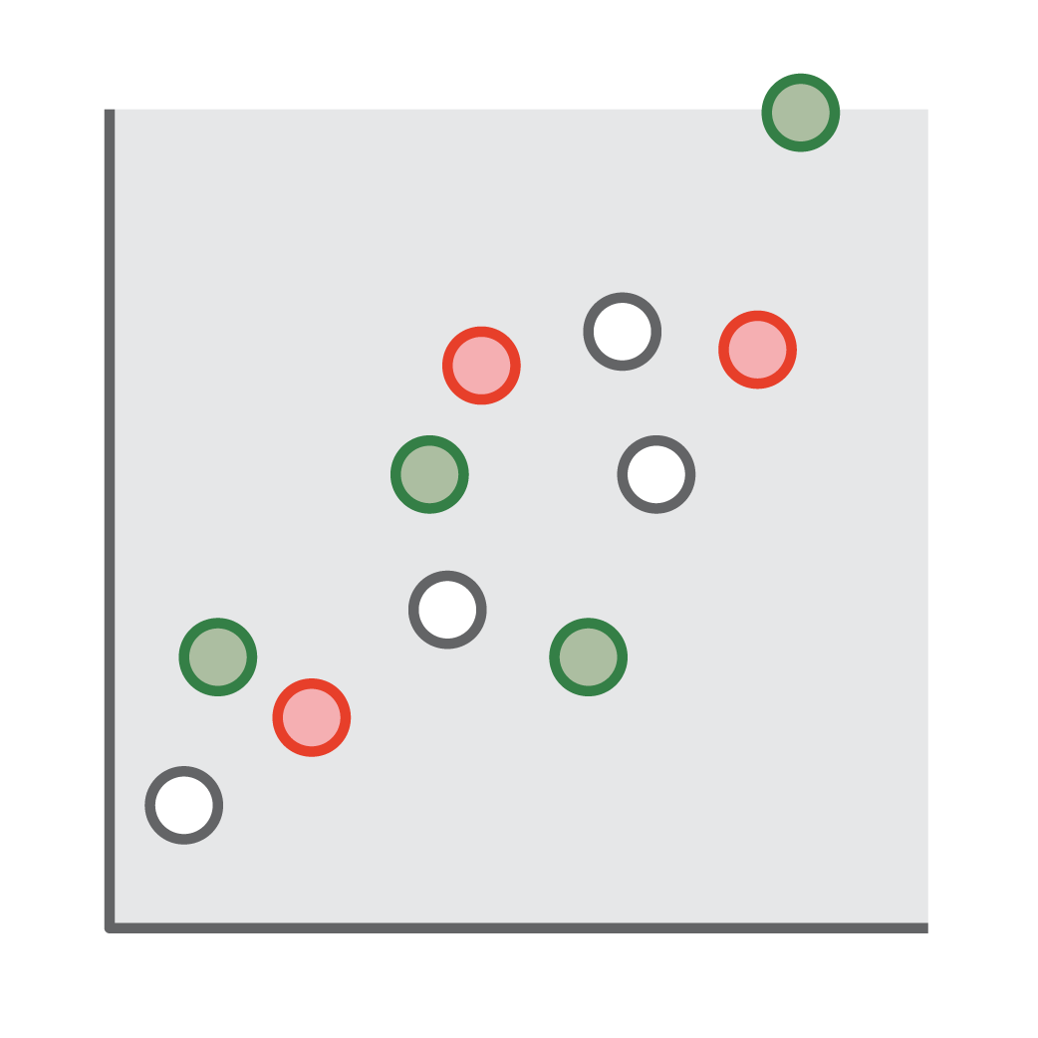
Challenges with Inference in Production
Training 10%
Low utilization and high costs
One size does not fit all

Slide 17
Amazon Elastic Inference
Reduce Deep Learning Inference costs up to 75%
Lower inference costs
Match capacity to demand
Available between 1 to 32 TFLOPS per accelerator
KEY FEATURES
Integrated with Amazon EC2 and Amazon SageMaker
Support for TensorFlow, Apache MXNet, and ONNX with PyTorch coming soon
Single and mixed-precision operations

Slide 18
Up to 75% Reduction in Inference Costs
Inferences per second
Inception-v3
ResNet-152
SSD
c5.large + eia1.medium - $0.22/hr
p2.xlarge - $0.90/hr
c5.large + eia1.large - $0.35/hr
p3.2xlarge - $3.06/hr
c5.large + eia1.xlarge - $0.61/hr

Slide 19
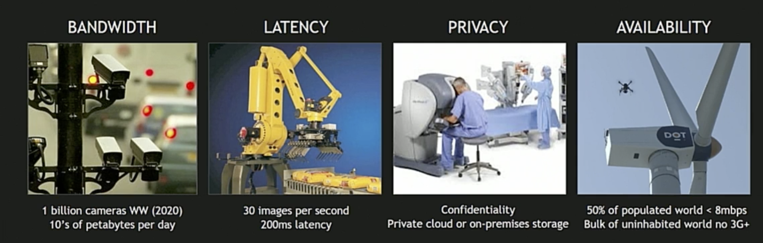
Requirements for Inference at the Edge

Slide 20
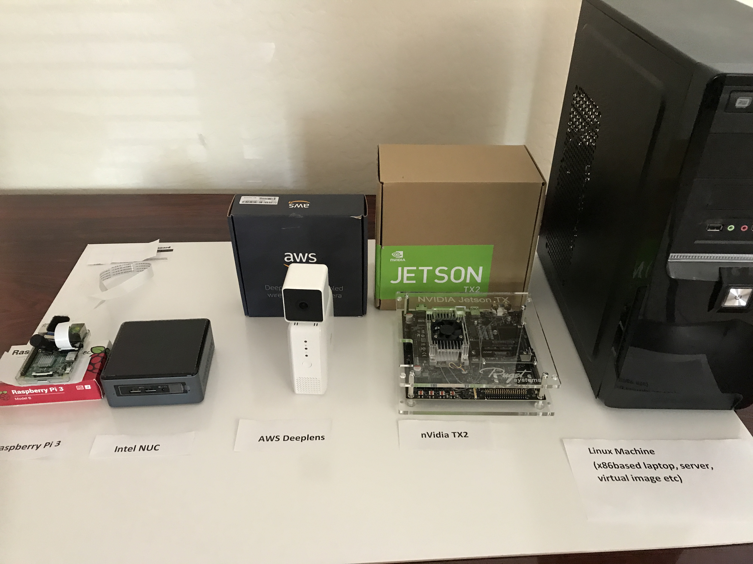
AWS Greengrass
Extend intelligence to the edge
Local actions
Local
triggers
Data and state sync
Security
Local resource access
Local ML inference

Slide 21
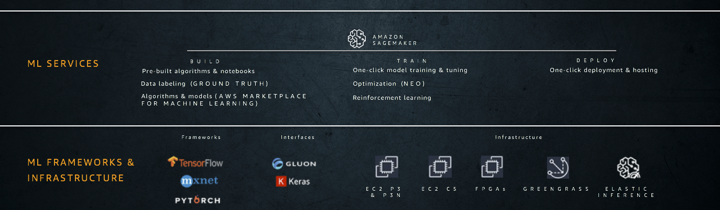
The Amazon ML stack: ML Services
Notes:
We see the Machine Learning stack having three key layers.
ML Frameworks:
The bottom layer is for expert machine learning practitioners—researchers and developers.
These are people who are comfortable building models, tuning models, training models, figuring out how to deploy into production, and manage them themselves.
And the vast majority of machine learning in the cloud today at this layer is being down through Amazon SageMaker which provides a managed experience for frameworks, or the AWS Deep Learning AMI that we built that effectively embeds all the major frameworks.
Infrastructure:
AWS offers a broad array of compute options for training and inference with powerful GPU-based instances, compute and memory optimized instances, and even FPGAs.
Our P3 instances provide up to 14 times better performance than previous-generation Amazon EC2 GPU compute instances.
C5 instances offer higher memory to vCPU ratio and deliver 25% improvement in price/performance compared to C4 instances, and are ideal for demanding inference applications.
We also have Amazon EC2 F1, a compute instance with field programmable gate arrays (FPGAs) that you can program to create custom hardware accelerations for your machine learning applications. F1 instances are easy to program and come with everything you need to develop, simulate, debug, and compile your hardware acceleration code. You can reuse your designs as many times, and across as many F1 instances as you like.
The new Amazon EC2 P3dn instance has four-times the networking bandwidth and twice the GPU memory of the largest P3 instance, P3dn is ideal for large scale distributed training. No one else has anything close.
P3dn.24xlarge instances offer 96vCPUs of Intel Skylake processors to reduce preprocessing time of data required for machine learning training.
The enhanced networking of the P3n instance allows GPUs to be used more efficiently in multi-node configurations so training jobs complete faster.
Finally, the extra GPU memory allows developers to easily handle more advanced machine learning models such as holding and processing multiple batches of 4k images for image classification and object detection systems
ML Services:
But, if you want to enable most enterprises and companies to be able to scale machine learning, we’ve solved that problem for organizations by making ML accessible for everyday developers and scientists. Amazon SageMaker removes the heavy lifting, complexity, and guesswork from each step of the machine learning process.
SageMaker makes model building and training easier by providing pre-built development notebooks, popular machine learning algorithms optimized for petabyte-scale datasets, and automatic model tuning, enabling developers to build, train, and deploy models in a single click.
SageMaker is already helping thousands of developers easily get started with building, training, and deploying models.
AI Services:
At the top layer are AI services which are ready-made for all developers—no ML skills.
For example, customers say here is an object, tell me what's in it, or here's a face, tell me if it's part of this facial group using Amazon Rekognition
Or let me translate text to speech using Amazon Polly
Or let’s build conversational apps with Amazon Lex.
Convert speech to text with Amazon Transcribe
Translate text between languages using Amazon Translate
Understand relationships and find insights from unstructured text using Amazon Comprehend

Slide 22
Amazon SageMaker
BRINGING MACHINE LEARNING TO ALL DEVELOPERS
Business Need as a ML Problem
Desired Business Outcome
Collect and prepare training data
Choose and optimize your ML algorithm
Set up and manage environments for training
Train and tune model
(trial and error)
Deploy model
in production
Scale and manage the production environment
SIMPLIFY THE END-TO-END MACHINE LEARNING PROCESS
Notes:
SageMaker is a managed service that takes a number of the required steps to build, train, tune, and deploy a ML model and makes it much easier for everyday developers and scientists.

Slide 23
Training Data for Supervised Learning
Challenges
?
Timely annotation of large data sets
Managing workforces.
Ensuring labeling quality
Handling workflows
Integration with ML development environment
Raw Data
Training Data

Slide 24
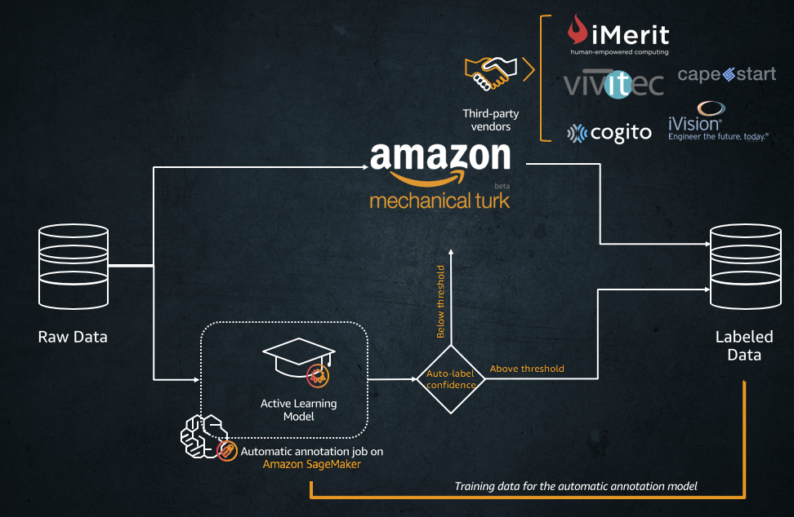
Amazon SageMaker Ground Truth
Label machine learning training data easily and accurately

Slide 25
Managed Notebooks: Exploration, Experimentation

Slide 26
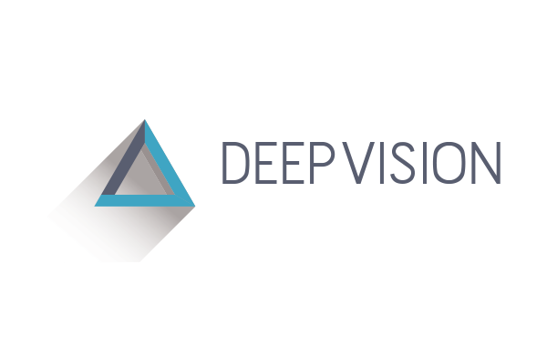
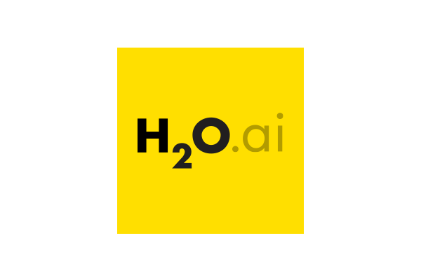








Your Choice. The Right Tools.
NATIVE SUPPORT FOR MOST POPULAR FRAMEWORKS
SAGEMAKER OPTIMIZED ALGORITHMS
INTEGRATION
BlazingText Algorithm
DeepAR Forecasting Algorithm
Factorization Machines Algorithm
Image Classification Algorithm
IP Insights Algorithm
K-Means Algorithm
K-Nearest Neighbors (k-NN) Algorithm
Latent Dirichlet Allocation (LDA) Algorithm
Linear Learner Algorithm
Neural Topic Model (NTM) Algorithm
Object2Vec Algorithm
Object Detection Algorithm
Principal Component Analysis (PCA) Algorithm
Random Cut Forest (RCF) Algorithm
Semantic Segmentation Algorithm
Sequence-to-Sequence Algorithm
XGBoost Algorithm

Slide 27
Zero Setup Training
INSTANCE 0
INSTANCE 1
INSTANCE 2
INSTANCE 0
GPU 0
GPU 0
GPU 0
GPU 0
GPU 1
GPU 1
GPU 1

Slide 28
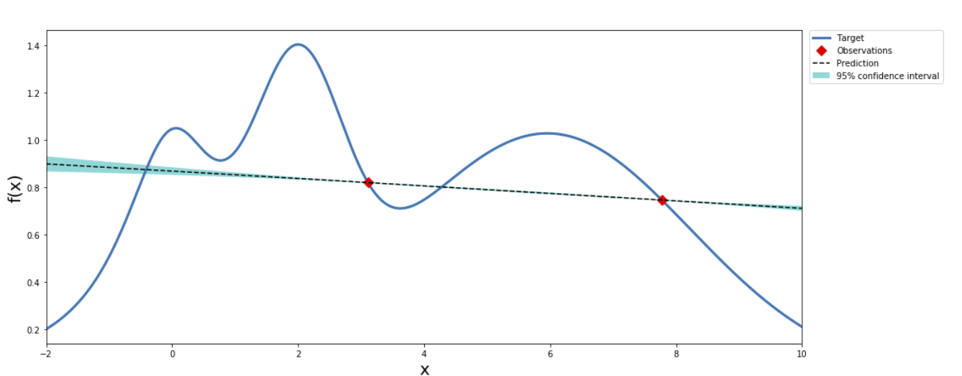
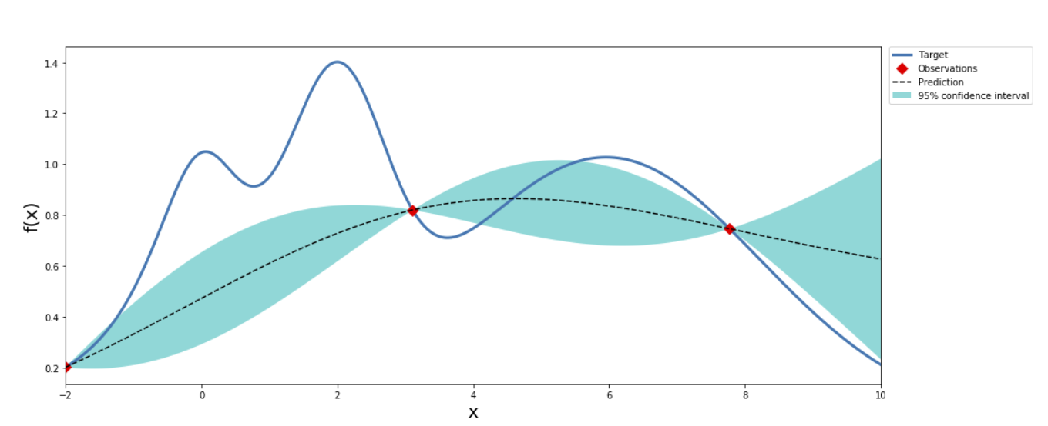
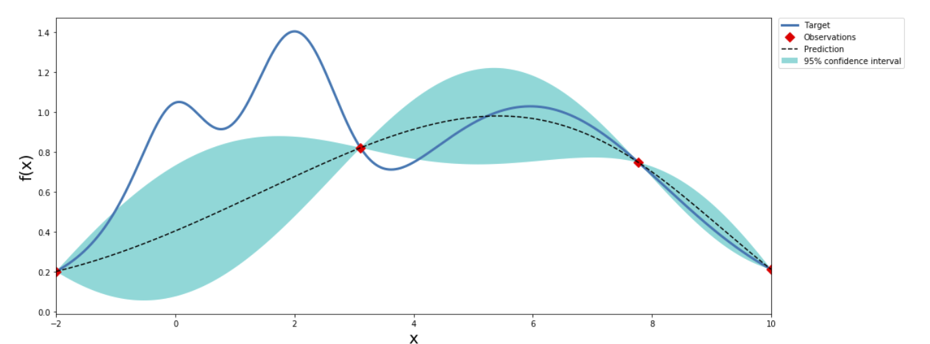
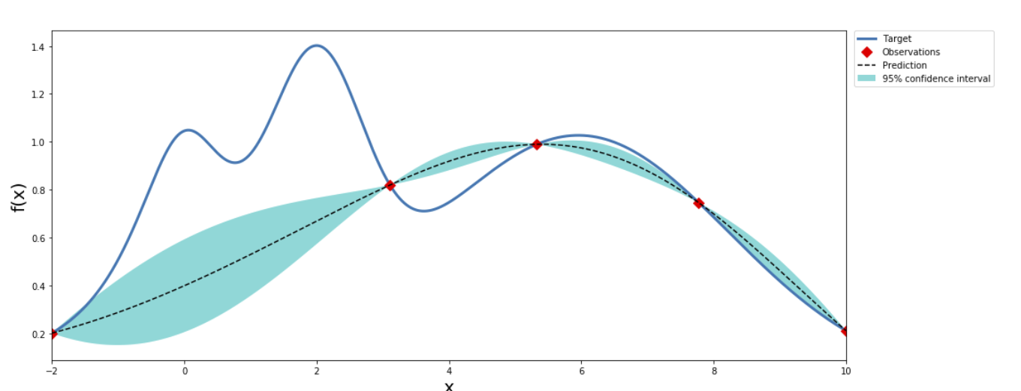
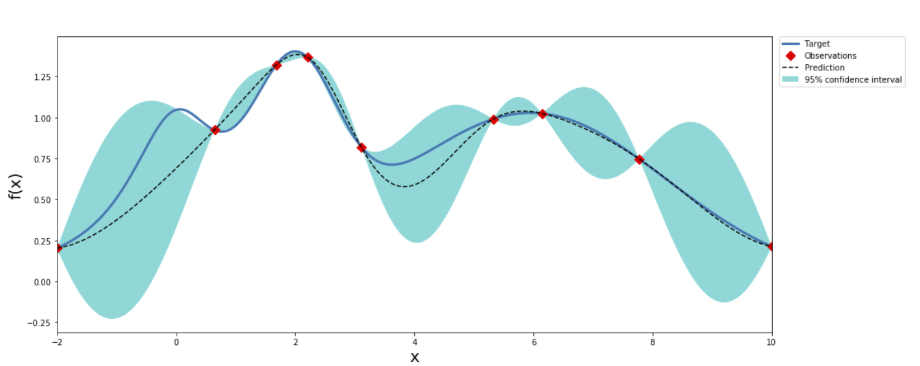
Automatic Model Tuning
…

Slide 29










Amazon SageMaker Neo
Train once, run everywhere with 2x performance and no accuracy lost
Automate Optimization
Neo

Slide 30

Simplified Model Deployment and Hosting
Auto-scaling
Performance monitoring
A/B Testing
Elastic Inference support
Suited for real-time and batch workloads
SageMaker Hosted Endpoints

Slide 31
Custom machine learning for your business
AMAZON SAGEMAKER
REDUCE COSTS
INCREASE PERFORMANCE
EASE-OF-USE
70%
10x
One-click
cost reduction for data labeling using Ground Truth
better algorithm performance
model training
& deployment
75%
2x
Train once
cost reduction for inference with Elastic Inference
performance increases from model optimization with Neo
run anywhere
Notes:
Amazon SageMaker is the most widely used machine learning service because it removes the complexity that holds back developer success
COSTS:
It helps reduce the costs of machine learning: Data labeling can be expensive and highly depending on human labelers for accuracy. Amazon SageMaker Ground Truth helps you get to that ‘ground truth’ for training data automatically, with accuracy and at scale with 70% reduction in labeling costs
Elasticity is really important. The resource requirements of models are hard to determine up-front and can change as models are trained with new data and updated algorithms. This means that getting the right balance of resources and cost often relies on guesswork or intuition and can be quickly out of date. Amazon Elastic Inference helps you provision just the right amount of GPU resources you need for your ML workloads
INCREASE PERFORMANCE
SageMaker comes pre-built with algorithms that perform 10 times better within SageMaker than anywhere else. You can also choose from additional algorithms and models in the AWS Marketplace for machine learning
With Amazon SageMaker Neo, you can continually optimize models for 2x performance gains, ensuring you have the highest performing models for inference (predictions)
EASE-OF-USE
SageMaker really does take the complexity out of machine learning—developers can get develop and deploy models with just one-click in the SageMaker console, and train once, run anywhere from the cloud to the edge
Industry leaders use SageMaker to transform their business—let’s take a look at some successes…

Slide 32
The Amazon ML stack: Broadest & deepest set of capabilities
Vision
Speech
Language
Chatbots
Forecasting
Recommendations
AI SERVICES
REKOGNITION
IMAGE
REKOGNITION
VIDEO
TEXTRACT
POLLY
TRANSCRIBE
TRANSLATE
COMPREHEND
LEX
FORECAST
PERSONALIZE
AMAZON SAGEMAKER
ML SERVICES
BUILD
TRAIN
DEPLOY
Pre-built algorithms & notebooks
One-click model training & tuning
One-click deployment & hosting
Data labeling (GROUND TRUTH)
Optimization (NEO)
Algorithms & models (AWS MARKETPLACE
FOR MACHINE LEARNING)
Reinforcement learning
Frameworks
Interfaces
Infrastructure
ML FRAMEWORKS & INFRASTRUCTURE
EC2 P3 & P3N
EC2 C5
FPGAs
GREENGRASS
ELASTIC INFERENCE
Notes:
We see the Machine Learning stack having three key layers.
ML Frameworks:
The bottom layer is for expert machine learning practitioners—researchers and developers.
These are people who are comfortable building models, tuning models, training models, figuring out how to deploy into production, and manage them themselves.
And the vast majority of machine learning in the cloud today at this layer is being down through Amazon SageMaker which provides a managed experience for frameworks, or the AWS Deep Learning AMI that we built that effectively embeds all the major frameworks.
Infrastructure:
AWS offers a broad array of compute options for training and inference with powerful GPU-based instances, compute and memory optimized instances, and even FPGAs.
Our P3 instances provide up to 14 times better performance than previous-generation Amazon EC2 GPU compute instances.
C5 instances offer higher memory to vCPU ratio and deliver 25% improvement in price/performance compared to C4 instances, and are ideal for demanding inference applications.
We also have Amazon EC2 F1, a compute instance with field programmable gate arrays (FPGAs) that you can program to create custom hardware accelerations for your machine learning applications. F1 instances are easy to program and come with everything you need to develop, simulate, debug, and compile your hardware acceleration code. You can reuse your designs as many times, and across as many F1 instances as you like.
The new Amazon EC2 P3dn instance has four-times the networking bandwidth and twice the GPU memory of the largest P3 instance, P3dn is ideal for large scale distributed training. No one else has anything close.
P3dn.24xlarge instances offer 96vCPUs of Intel Skylake processors to reduce preprocessing time of data required for machine learning training.
The enhanced networking of the P3n instance allows GPUs to be used more efficiently in multi-node configurations so training jobs complete faster.
Finally, the extra GPU memory allows developers to easily handle more advanced machine learning models such as holding and processing multiple batches of 4k images for image classification and object detection systems
ML Services:
But, if you want to enable most enterprises and companies to be able to scale machine learning, we’ve solved that problem for organizations by making ML accessible for everyday developers and scientists. Amazon SageMaker removes the heavy lifting, complexity, and guesswork from each step of the machine learning process.
SageMaker makes model building and training easier by providing pre-built development notebooks, popular machine learning algorithms optimized for petabyte-scale datasets, and automatic model tuning, enabling developers to build, train, and deploy models in a single click.
SageMaker is already helping thousands of developers easily get started with building, training, and deploying models.
AI Services:
At the top layer are AI services which are ready-made for all developers—no ML skills.
For example, customers say here is an object, tell me what's in it, or here's a face, tell me if it's part of this facial group using Amazon Rekognition
Or let me translate text to speech using Amazon Polly
Or let’s build conversational apps with Amazon Lex.
Convert speech to text with Amazon Transcribe
Translate text between languages using Amazon Translate
Understand relationships and find insights from unstructured text using Amazon Comprehend

Slide 33
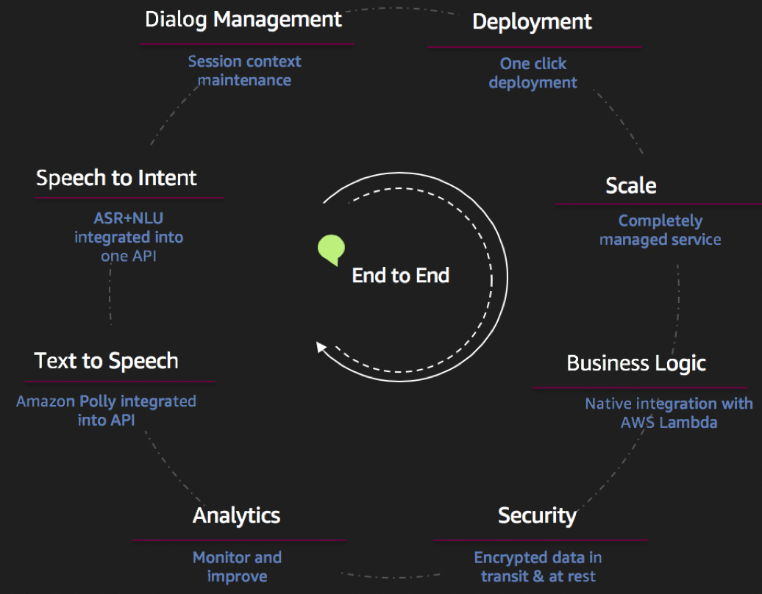
Chatbots with Amazon Lex

Slide 34
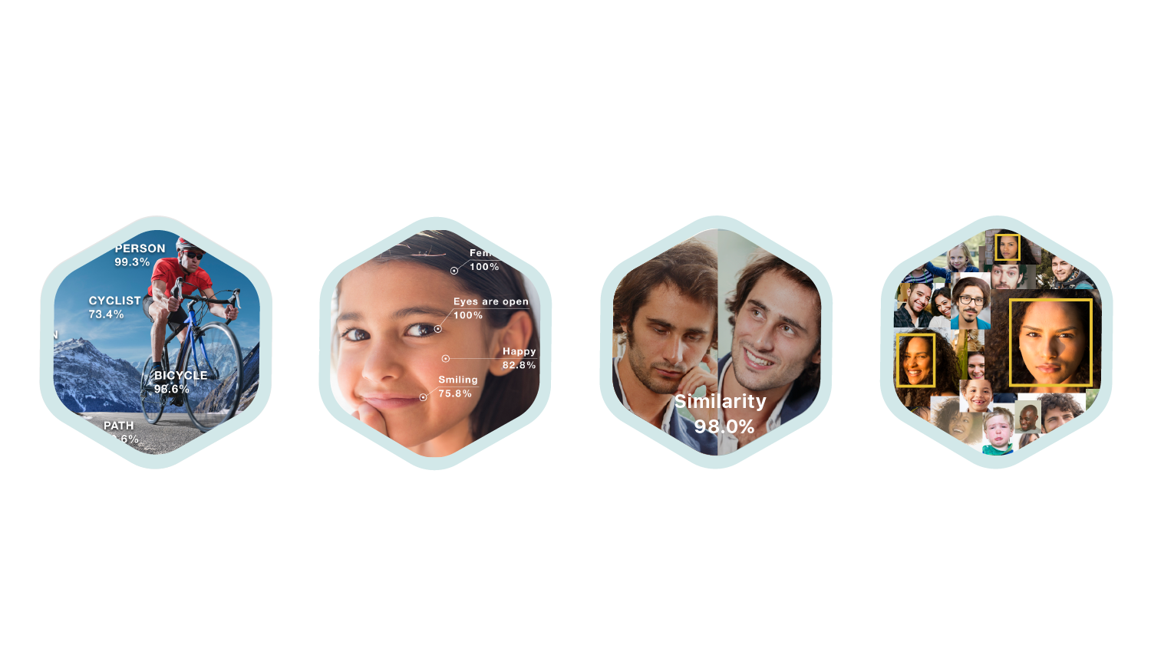




Vision: Amazon Rekognition
IMAGES
Object and Scene
Detection
Facial
Analysis
Face
Recognition
Unsafe Image Detection
Celebrity Recognition
Text in Image
VIDEO
Person Tracking
Real-time Live Stream

Slide 35
Vision: Amazon Rekognition
IMAGES
Object and Scene
Detection
Facial
Analysis
Face
Recognition
Unsafe Image Detection
Celebrity Recognition
Text in Image
VIDEO
Person Tracking
Real-time Live Stream

Slide 36
The Connected Worker
WORKER SAFETY
COMPLIANT
WORKER TRACKING
JOHN
DAVE

Slide 37
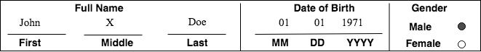
Vision: Amazon Textract
Form Extraction simplified
Logical groupings captured
Relationships captured
Glyphs captured
Output
Full Name:
First: John
Middle: X
Last: Doe
Date of Birth:
MM: 01
DD: 01
YYYY: 1971
Gender:
Male: True
Female: False

Slide 38
NLP: Amazon Comprehend
Named Entities
Amazon.com: Organization
Seattle, WA : Location
July 5th,1994: Date
Jeff Bezos : Person
Keyphrases
Our customers
books
blenders
great prices
Sentiment
Positive
Language
English
Amazon.com, Inc. is located in Seattle, WA and was founded July 5th, 1994 by Jeff Bezos. Our customers love buying everything from books to blenders at great prices

Slide 39



More Natural Language Processing…
LANGUAGE
TRANSLATION
TEXT-TO-SPEECH
SPEECH-TO-TEXT
A m a z o n
P o l l y
A m a z o n
T r a n s c r i b e
A m a z o n
T r a n s l a t e

Slide 40




Solution Acceleration: Intelligent Building Blocks
Converted
Text
A m a z o n
T e x t r a c t
Text Analytics
A m a z o n
C o m p r e h e n d
Converted
Text
“Branded Voice”
A m a z o n
T r a n s c r i b e
Translation
Response
A m a z o n
T r a n s l a t e
A m a z o n
L e x
A m a z o n
P o l l y

Slide 41


AutoML: Tailored Models Automated
FORECASTING
RECOMMENDATIONS
A m a z o n
F o r e c a s t
A m a z o n
P e r s o n a l i z e

Slide 42
Computer Vision on AWS Jumpstart

Slide 43
Jumpstart Workshop Menu
Object Detection
TBD…

Slide 44
Object Detection Workshop

Slide 45
Reference Architectures

Slide 46
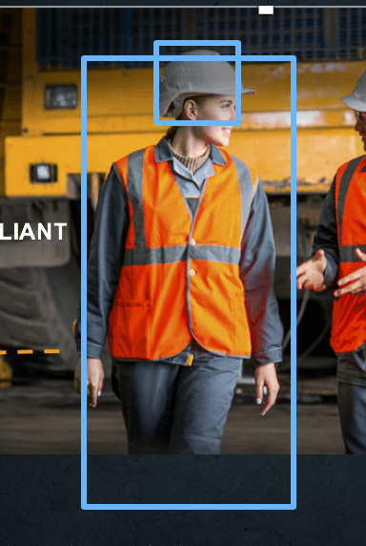
Cloud Inference on Streaming Video

Slide 48
Workshop Objectives and Agenda

Slide 49


Select the Right Strategy
Object Detection,
Segmentation,
Classification…
Amazon SageMaker
“Bring Your Own Algorithm”
Scope of Use Cases
Amazon SageMaker
“Bring Your Own Script”
Amazon SageMaker
Algorithms
Amazon Rekognition
Time to Market
Fully managed APIs. No ML development required
Integrate any algorithm and benefit from automation.
Full control over running TensorFlow, PyTorch, MXNet, Sklearn… scripts.
No need for managing SageMaker compliant containers.
Full control over data sets, and hyperparameter tuning. No coding.

Slide 50
Right Tool for the Use Case
SEGMENTATION
CUSTOM OBJECT DETECTION
Amazon SageMaker
COMPLIANT
Amazon Rekognition
FACE
SEARCH
PEOPLE TRACKING
JOHN
DAVE

Slide 51
Amazon SageMaker
BRINGING MACHINE LEARNING TO ALL DEVELOPERS
Business Need as a ML Problem
Desired Business Outcome
Collect and prepare training data
Choose and optimize your ML algorithm
Set up and manage environments for training
Train and tune model
(trial and error)
Deploy model
in production
Scale and manage the production environment
SIMPLIFY THE END-TO-END MACHINE LEARNING PROCESS
Notes:
SageMaker is a managed service that takes a number of the required steps to build, train, tune, and deploy a ML model and makes it much easier for everyday developers and scientists.

Slide 52
Lab 1: Managing a high quality training set at scale using SageMaker GroundTruth
Business Need as a ML Problem
Desired Business Outcome
Collect and prepare training data
Choose and optimize your ML algorithm
Set up and manage environments for training
Train and tune model
(trial and error)
Deploy model
in production
Scale and manage the production environment
SIMPLIFY THE END-TO-END MACHINE LEARNING PROCESS

Slide 53
Lab 2: Train, tune and deploy a custom object detector (SSD) with zero coding.
Business Need as a ML Problem
Desired Business Outcome
Collect and prepare training data
Choose and optimize your ML algorithm
Set up and manage environments for training
Train and tune model
(trial and error)
Deploy model
in production
Scale and manage the production environment
SIMPLIFY THE END-TO-END MACHINE LEARNING PROCESS

Slide 54
Lab 3: “Bring Your Own Script:” train, tune and deploy a custom object detector (YOLOv3) on GluonCV (MXNet).
Business Need as a ML Problem
Desired Business Outcome
Collect and prepare training data
Choose and optimize your ML algorithm
Set up and manage environments for training
Train and tune model
(trial and error)
Deploy model
in production
Scale and manage the production environment
SIMPLIFY THE END-TO-END MACHINE LEARNING PROCESS

Slide 55

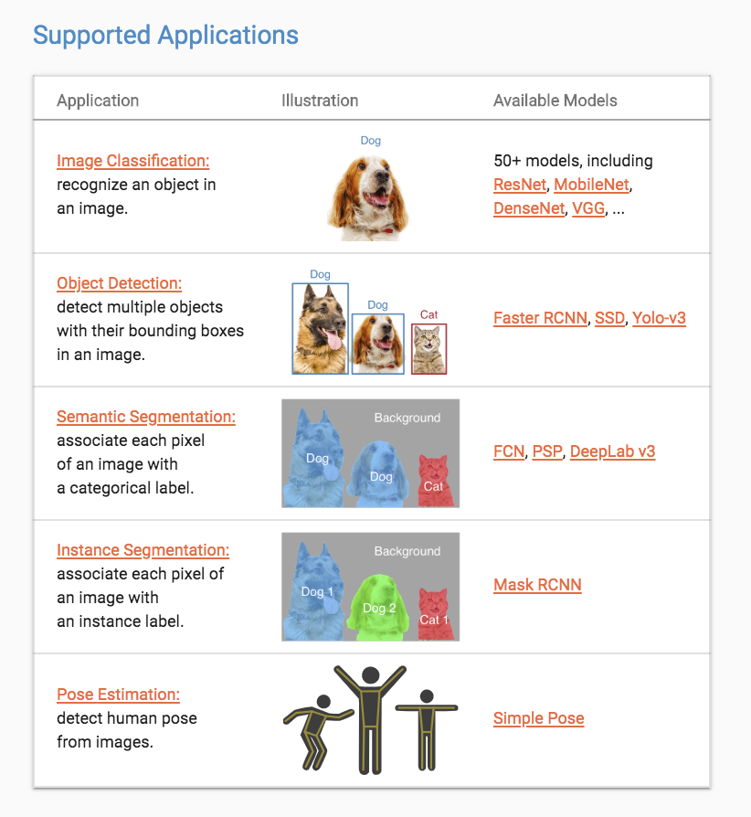
Algorithm variants : For instance, in Object Detection, different algorithms offer trade-offs between accuracy (mAP) and latency (fps)

Slide 56
Future labs
By feedback and demand! dylatong@amazon.com
Recognition:
Face Search
People Tracking
Textract solutions
More Amazon SageMaker use cases:
Segmentation, Pose Estimation, Similarity Search

Slide 57
Lab 1

Slide 58
Manage a high-quality data set at scale
Launch a Notebook Instance.
Manage a private workforce.
Create an annotation job for Object Detection.
Generate a dataset and metadata compatible with Amazon SageMaker algorithms without further data wrangling!

Slide 59
Lab 2

Slide 60
Create a custom object detector with zero coding
SAGEMAKER OPTIMIZED ALGORITHMS
Configure a hyperparameter tuning job for an Object Detection Algorithm.
Train on GPU
Deploy a managed endpoint.
Test and visualize!
BlazingText Algorithm
DeepAR Forecasting Algorithm
Factorization Machines Algorithm
Image Classification Algorithm
IP Insights Algorithm
K-Means Algorithm
K-Nearest Neighbors (k-NN) Algorithm
Latent Dirichlet Allocation (LDA) Algorithm
Linear Learner Algorithm
Neural Topic Model (NTM) Algorithm
Object2Vec Algorithm
Object Detection Algorithm
Principal Component Analysis (PCA) Algorithm
Random Cut Forest (RCF) Algorithm
Semantic Segmentation Algorithm
Sequence-to-Sequence Algorithm
XGBoost Algorithm

Slide 61
Lab 3

Slide 62
Bring Your Own Script and automate the ML process
Examples
Training: Only modifications required is to set script certain parameters values from SageMaker container environment variables.
GluonCV YOLOv3 training script
PyTorch Siamese Network training script
Inference: requires overriding programmatic interface implementation.
GluonCV YOLOv3 model serving script
PyTorch Siamese Network model serving script
input_fn: request format pre-processing
model_fn: how to load the model
predict_fn: inference logic
output_fn: response format processing
Bring your own YoloV3 script on GluonCV
Prepare your data set and environment
Explore and prototype locally
Automate model tuning, and train
Deploy, test and visualize!

Slide 63
https://github.com/dylan-tong-aws/aws-cv-jumpstarter

Slide 64
aws.ai

Slide 65
Appendix

Slide 66
Advanced Analytics
SENTIMENT AND TOPIC ANALYSIS
A m a z o n
C o m p r e h e n d
INVENTORY AND SUPPLY MANAGEMENT: FORECASTED DEMAND
Data Lake
A m a z o n
F o r e c a s t
CUSTOMER PREFERENCES
A m a z o n
P e r s o n a l i z e
CUSTOM MODELS: ANOMALIES, PREDICTIVE MAINTENANCE, OTHER OPTIMIZATION OPPORTUNITIES
AMAZON SAGEMAKER

Slide 67
ML Solutions Lab
How we can help…
Brainstorming
Custom modeling
Training
Work side-by-side with Amazon experts
Machine Learning Training & Certification
Practical education on ML for new & experienced practitioners
Based on the same material used to train Amazon developers
Notes:
ML Solutions Lab is a program to help you accelerate your use of machine learning in products and processes.
The Amazon ML Solutions Lab pairs your team with Amazon machine learning experts to prepare data, build and train models, and put models into production.
It combines hands-on educational workshops with brainstorming sessions and advisory professional services to help you ‘work backwards’ from business challenges, and then go step-by-step through the process of developing machine learning-based solutions.
At the end of the program, you will be able to take what you have learned through the process and use it elsewhere in your organization to apply ML to business opportunities.
Toyota Research Institute, Johnson & Johnson and MLB used the ML Solutions Lab to kick start their ML projects.
https://aws.amazon.com/ml-solutions-lab/
Machine Learning Training and Certification courses introduce AWS customers and current and potential machine learning practitioners to the practical Amazon approach to machine learning (ML)
https://aws.amazon.com/training/learning-paths/machine-learning/

Slide 68
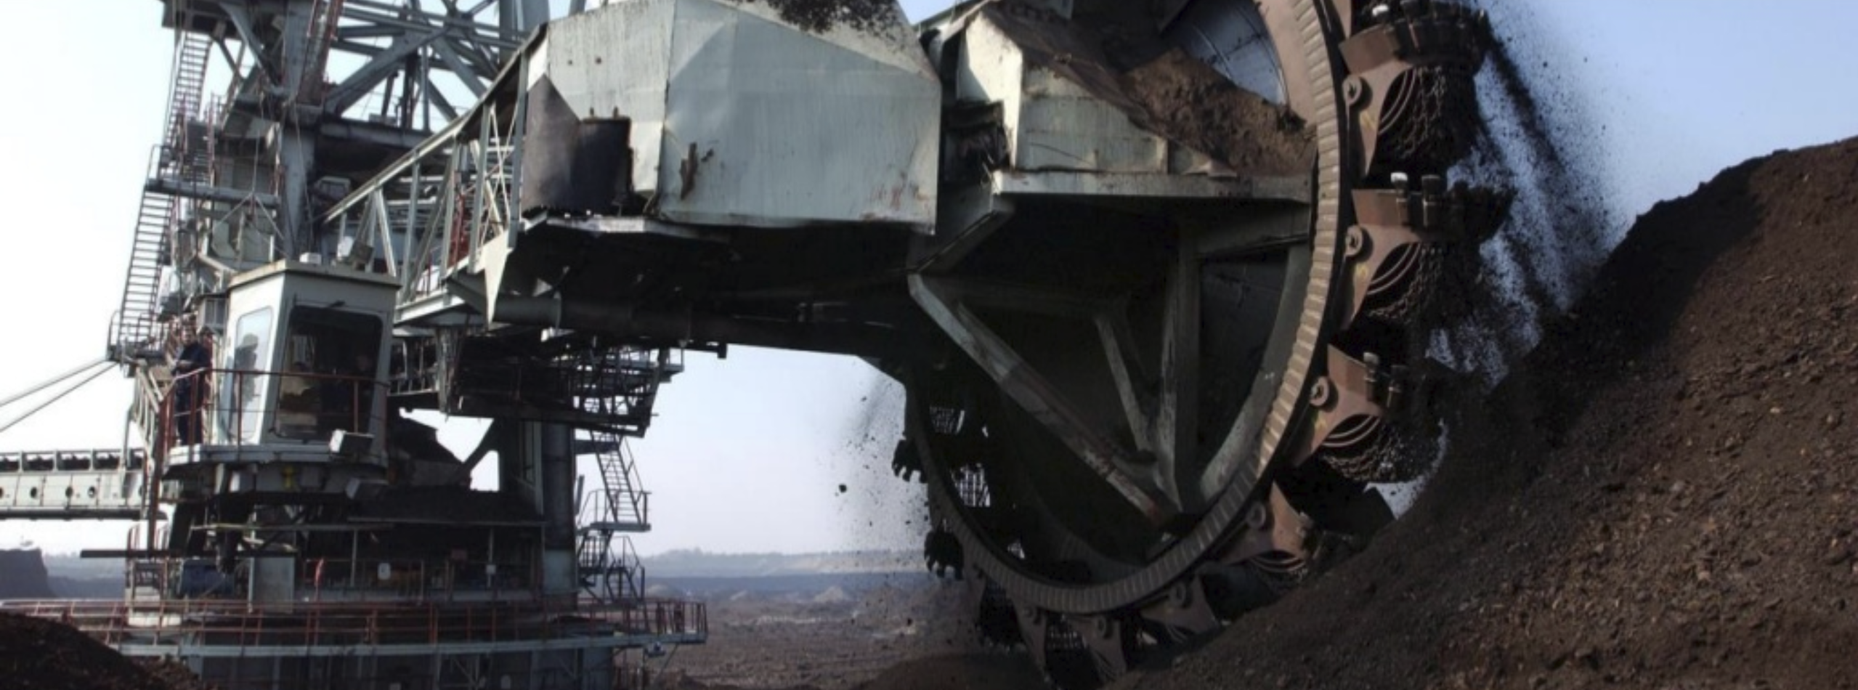

SKF: Smart Lubricator

Slide 69

Global flexibility
Verint uses Amazon Translate to offer companies load balancing across global call centers that help responding faster to customers in their own language 24x7 without native speaker resource dependencies.
Notes:
Verint is a global leader providing actionable intelligence that empowers organizations to simplify, modernize and automate their customer engagement.
By leveraging Verint’s Agent Desktop Chat integrated with Amazon Translate, Verint offers companies global flexibility, providing load balancing across call centers and driving cost reduction through consolidation and removal of multilingual resource dependencies.
Companies gain the opportunity to improve customer satisfaction and retention by responding faster to customers in their own language,24x7
“Verint is a global leader providing actionable intelligence that empowers organizations to simplify, modernize and automate their customer engagement. When organizations can quickly anticipate, respond to and take action for their customers, everyone wins. By leveraging Verint’s Agent Desktop Chat integrated with Amazon Translate, we offer companies global flexibility, providing load balancing across call centers and driving cost reduction through consolidation and removal of multilingual resource dependencies. Companies may save money by supporting customers from anywhere in the world and reducing dependency on in-country native speakers—and they gain the opportunity to improve customer satisfaction and retention by responding faster to customers in their own language, 24x7. With Amazon Translate in our workflow, existing Verint knowledge and response templates can be translated in real time, reducing risk and delighting customers.” -John Bourne, SVP Global Channels and Alliances, Verint CES

Slide 70



Enhancing the fan experience
One week of NFL games now creates 3TB of data. NFL uses Amazon SageMaker to analyze telemetry data to predict plays. Computations that could take months to refine now take only weeks or days.
WATCH VIDEO >>
Notes:
The National Football League has 180 million fans worldwide. About 17 million of those trek out to stadiums each season—which means over 90% of NFL fans are catching the games on TV, online, and mobile. One week of NFL games now creates 3TB of data
The NFL has been keeping statistics since 1920. But most of the stats that it displays to the public had been pretty standard for the past several decades. It was the kind of stuff you see on trading cards and game programs—yards passing, yards rushing, catches, tackles, quarterback sacks, interceptions, etc.
Using Amazon SageMaker to easily build, train and run these predictive models helped reduce the time to get to results from as much as 12 hours to 30 minutes.
“At the NFL, we are more efficient in the development of metrics for the Next Gen Stats offering by leveraging AWS technology. Machine Learning and other computations that could take months to refine now take weeks or days, allowing us to engage, inform and excite the fan in new and unique ways.” Matt Swensson, Vice President, Emerging Products and Technology at the NFL
MORE INFO:
AWS & WSJ feature: https://partners.wsj.com/aws/how-machine-learning-and-analytics-are-transforming-the-nfl-ai/
https://aws.amazon.com/nextgenstats/

Slide 71





Put AI to work for your business
Automate media workflows to reduce costs & monetize content
content moderation | contextual ad insertion | searchable media library
custom facial recognition | multi-language metadata search
REKOGNITION
IMAGE
REKOGNITION
VIDEO
COMPREHEND
TRANSCRIBE
TRANSLATE
TEXTRACT
Notes:
Why optimize media workflows?
Almost 1 million people started using social media for the first time every day in 2017 — that’s equivalent to more than 11 new users every second. https://blog.hootsuite.com/11-people-join-social-every-second/
To meet the needs of content personalization and recommendations and intelligent search, you need to build an end-to-end, cloud-based workflow to facilitate collaboration, dynamic editing including social media content
How do AI Services from AWS help?
AI services significantly reduce the time and effort required to process and extract meaningful information from your media files.
You can transcribe and translate content, tag content and make it available for intelligent search and content personalization
Provide insights into images, videos, audio files, and transcripts without the need to develop extensive knowledge in deep-learning algorithms or manage underlying infrastructures.
For example, customers can automatically process content through Rekognition (Moderation, Labels, Text, Faces, Celebrity) and their compliance workers can focus on what’s been flagged, reducing the need to review every single minute of content. This reduces labor intensity and cost with faster turn around.
Customer examples:
C-Span: C-SPAN is a public service that provides gavel-to-gavel proceedings of the U.S. House of Representatives and the U.S. Senate, and to other forums where public policy is discussed, debated and decided––all without editing. Using Rekognition, it more than doubled the amount of video that could be indexed annually, from 3,500 to 7,500 hours. Reduced labor required to index an hour of video from 1 hour to 20 minutes. Uploaded 97,000 images in less than two hours. Deployed in less than three weeks. Highly accurate facial recognition with unlimited scalability at affordable cost.
PopSugar: POPSUGAR Inc. is a global media and technology company that delivers multi-platform content to a global audience of over 400 million. It used Rekognition to identify celebrities in a huge digital asset library. Amazon Rekognition enabled the company to stop manually tagging thousands of photos and provides us with much needed automation for our ever-growing library.
TINDER: Tinder is a location-based social search mobile app that allows users to like or dislike other users, and allows users to chat if both parties swiped to the right. Used Rekognition to tag user photos. Compelling tags show a 20% lift in engagement in Top Picks

Slide 72


Scaling video indexing
C-SPAN uses Amazon Rekognition to automatically index video news footage for search. With Rekognition, C-SPAN reduced indexing time per video from 1 hour to 20 minutes and uploaded 97,000 images in under 2 hours.
Notes:
C-SPAN is a public service that provides gavel-to-gavel proceedings of the U.S. House of Representatives and the U.S. Senate, and to other forums where public policy is discussed, debated and decided––all without editing.
Using Rekognition, it more than doubled the amount of video that could be indexed annually, from 3,500 to 7,500 hours.
C-SPAN reduced the labor required to index an hour of video from 1 hour to 20 minutes. Uploaded 97,000 images in less than two hours.
Deployed in less than three weeks.

Slide 73


Meaningful customer interactions
Liberty Mutual uses Amazon Lex and AI Services to develop natural language-driven conversational apps to allow customer service agents to respond to customer requests with real-time and contextual intelligence, improving response time, and quality of service.
Notes:
Liberty Mutual: Liberty Mutual Insurance uses services like Amazon Lex to help answer employee questions to increase their efficiency and productivity, and to quickly get them the information they need to help customers.
The use of services like Lex take advantage of natural language, which means it’s easy for employees to get started. With conversational Ai, they don’t have to learn a whole new system. The digital assistant can answer common questions or help with simple tasks.
While the Liberty Mutual team considered building its own natural language processing service, it was made more sense to take advantage of something already developed so the team could progress quickly. To experiment, and also now that it’s proven to integrate it with an existing internal productivity suite.
Another critical element here was the data. In developing the digital assistant for employees, there wasn’t a lot of existing data, so the team needed to sit down with users to research the kinds of issues and problems they needed help with. And some of this data also revealed how people in different countries use different words and phrases to say the same thing, so it was essential to get to ground truth with data.
So while Liberty Mutual initially looked to increase productivity on the employee side in order to help customers, the conversational AI will also be applied in the call center sphere to helping customers quickly find answers to simple questions without waiting to speak to a representative — for example, finding out who may be responsible for a given claim or whether a customer’s coverage includes a rental car.

Slide 74




Put AI to work for your business
Use AI services to strengthen safety & security
accurate facial analysis | identity protection | metadata extraction
REKOGNITION
IMAGE
REKOGNITION
VIDEO
COMPREHEND &
COMPREHEND MEDICAL
Notes:
Why AI for safety and security?
There are an estimated 40.3 million victims of human trafficking globally according to The International Labor Organization. 81 percent of these victims are trapped in forced labor--$150 billion industry worldwide. https://polarisproject.org/human-trafficking/facts
How do AI Services from AWS help?
Using Amazon Comprehend and Amazon Rekognition can help detect emotions like happiness, sadness, or surprise from facial images as well as detect sentiment in text.
Face-based user verification with Amazon Rekognition, your applications can confirm user identities by comparing their live image with a reference image.
Amazon Rekognition Video allows you to create applications that help find missing persons in social media video content. By recognizing their faces against a database of missing persons that you provide, you can accurately flag matches and speed up a rescue operation.
Customer examples:
THORN: Thorn’s tools have been used to identify 5,894 child sex trafficking victims and rescue 103 children where their sexual abuse was recorded and distributed. Using Rekognition, Thorn has seen a 65% reduction in investigation time, which means finding more victims at a faster pace. https://aws.amazon.com/blogs/machine-learning/thorn-partners-with-amazon-rekognition-to-help-fight-child-sexual-abuse-and-trafficking/
Marinus Analytics: Marinus Analytics provides law enforcement with tools, founded in artificial intelligence, to turn big data into actionable intelligence. The Marinus flagship software, Traffic Jam, is a suite of tools for use by law enforcement agencies on sex trafficking investigations. Using Rekognition, investigators are able to take effective action by searching through millions of records in seconds to find victims. https://aws.amazon.com/blogs/machine-learning/marinus-analytics-fights-human-trafficking-using-amazon-rekognition/
Aella Credit: Aella Credit provides instant loans to individuals with a verifiable source of income in emerging markets using biometric, employer, and mobile phone data. Using Amazon Rekognition for identity verification on its mobile application has reduced verification errors significantly and given Aella the ability to scale. It now detect and verify an individual’s identity in real time without any human intervention, thereby allowing faster access to products.
Paylater: Paylater is a digital financial service platform powered by OneFi that provides services to underbanked individuals in West Africa through an Android mobile app, which has over 900,000 downloads. Paylater wanted to be able to identify if a human face was truly detected in an uploaded image and identify other labels such as gender and identity. It used Rekognition because of its ease in adding image analysis to our mobile app and the accuracy of its facial analysis.

Slide 75




Put AI to work for your business
Reduce localization costs & improve accuracy
custom vocabulary | timestamp generation | secure real-time translation | language identification
POLLY
TRANSCRIBE
TRANSLATE
COMPREHEND
Notes:
Why localization?
As companies increasing become global and people are connecting across platforms, channels and languages, localization is becoming more important.
This means being able to have your content, products, processes all translate to relevant markets and be accessible by all potential customers
This can be a time consuming, expensive, manual and error-prone process
How do AI Services from AWS help?
Using AI services automates the process of transcription, translation and text-to-speech, while improving accuracy.
For example, Amazon Polly offers voices 54 voices in 27 languages. Translate offers more than a dozen languages. All this helps to expand your global reach which increasing efficiency and productivity.
Customer examples:
Isentia, headquartered in Sydney, Australia, is a leading media-intelligence provider for the Asia-Pacific region. The company operates from 18 offices across the region and supports more than 5,000 clients worldwide, including 84 of the world’s top 100 brands. Isentia’s products help customers make more informed and timely business and communication decisions.
“At Isentia, we enable customers to analyze and monitor the media coverage for their brands. We create more than 13K summaries per day from radio and TV content. With Amazon Transcribe, we can transcribe all the audio/video content that we monitor and analyze the text data with Amazon Comprehend. Features like timestamps and punctuation make it very easy for us to search through the data and drill down and present key insights for our customers to review."Andrea Walsh - CIO, Isentia
RingDNA is an enterprise sales acceleration engine and voice communications platform. Inside sales teams use RingDNA to dramatically increase productivity, engage in smarter sales conversations, gain predictive sales insight and coach reps to success faster than ever before.
“RingDNA is an end-to-end communications platform for sales teams. Hundreds of enterprise organizations use RingDNA to dramatically increase productivity, engage in smarter sales conversations, gain predictive sales insights, improve their win rate and coach reps to success faster than ever before. A critical component of RingDNA’s Conversation AI requires best of breed speech-to-text to deliver transcriptions of every phone call. RingDNA is excited about Amazon Transcribe since it provides high-quality speech recognition at scale, helping us to better transcribe every call to text.”Howard Brown – CEO & Founder, RingDNA
Hotels.com is a leading online accommodation booking website with all the information needed to book the perfect stay.
“At Hotels.com, we are committed to offering all of our customers the most relevant and up to date information about their destination. To achieve that, we operate 90 localized websites in 41 languages. We have more than 25M Customer reviews and more are coming in every day, making a great candidate for machine translation. Having evaluated Amazon Translate and several other solutions, we believe that Amazon Translate presents a quick, efficient and most importantly, accurate solution. We want to take advantage of the latest advances in machine learning and the transition to Neural engines to further personalize and localize our reviews, and generally improve our customer experience. Amazon Translate is a step forward in that direction."Matthew Fryer - VP and Chief Data Science Officer, Hotels.com
Lionbridge is one of world’s largest language services provider offering industry-leading translation and localization services and highly scalable global marketing solutions.
“Today’s digital businesses are pressured to produce ever more content, faster, and with greater relevance. Human translators armed with machine translation help companies localize more content, faster, more affordably and into more languages. Based on our experience, pairing Amazon Translate with a human editor, we believe we can produce cost efficiencies by up to 20 percent. Ken Watson - CTO, Lionbridge

Slide 76

Scaling real-time translation
Using Amazon Translate, Lionbridge is able to scale machine translation in order to localize content faster and in more languages. Using Translate, Lionbridge was able to reduce translation costs by 20 percent.
Notes:
Lionbridge is one of world’s largest language services provider offering industry-leading translation and localization services and highly scalable global marketing solutions.
“Today’s digital businesses are pressured to produce ever more content, faster, and with greater relevance. Human translators armed with machine translation help companies localize more content, faster, more affordably and into more languages. Based on our experience, pairing Amazon Translate with a human editor, we believe we can produce cost efficiencies by up to 20 percent. Ken Watson - CTO, Lionbridge

Slide 77
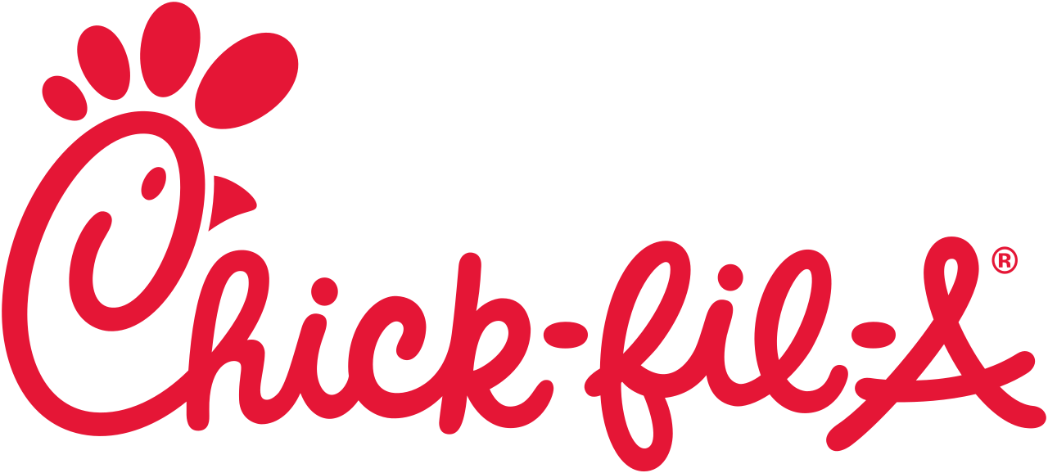



Put AI to work for your business
Understand the voice of your customer
sentiment analysis | app localization | translation services | transcription services | cataloging media | accessibility
REKOGNITION
IMAGE
REKOGNITION
VIDEO
TRANSCRIBE
TRANSLATE
COMPREHEND
Notes:
Why voice of customer analytics?
Customers are speaking more loudly than ever before (social Media, product reviews, comments, etc.) but are you listening, real-time, and getting the most insight from those voices?
The unstructured text of the current voice of the customer is a gold-mine of insights that can be intelligently analyzed to improve your customer understand, and provide a better connection, recommendations, and services.
By most estimates at least 75 percent of an organization’s data — floats under the waterline, beneath the structured tip of the data iceberg - https://www.propertycasualty360.com/2016/12/27/digging-into-unstructured-data-with-text-analytics/?slreturn=20180920194730
Why personalization?
Consumers in the United States spend about the same amount of time sleeping each day—an average 7.8 hours—as they do engaging with digital content. https://www.cmo.com/features/articles/2018/1/31/adobe-2018-consumer-content-survey.html#gs.z75px1Y
Epsilon research indicates 80% of consumers are more likely to make a purchase when brands offer personalized experiences: http://pressroom.epsilon.com/new-epsilon-research-indicates-80-of-consumers-are-more-likely-to-make-a-purchase-when-brands-offer-personalized-experiences/
By 2018, companies that have “fully invested in all types of personalization” will outsell companies that have not by 20 percent. https://contently.com/2017/03/31/personalization-changing-content-marketing/
How does AI Services from AWS help?
AI Services allow you to find insights and relationships in text to determine how positive or negative it is.
You can analyze customer interactions in the form of support emails, social media posts, online comments, telephone transcriptions, etc., and discover what factors drive the most positive and negative experiences. You can then use these insights to improve your products and services and even recommend the right content at the right moment.
You can pair the capabilities of Amazon Comprehend (NLP for text analytics) with Amazon Rekognition (for image and video analytics), as well as Amazon Transcribe and Translate to create VoC solutions
Customer examples:
VidMob – VidMob is an award-winning technology platform that connects marketers of all sizes with a network of highly trained video creators, enabling businesses to dramatically improve their video marketing. Uses Amazon Rekognition and Amazon Transcribe to help marketers get smarter about creative, and react, in real time, to data with freshly optimized media. More: https://aws.amazon.com/blogs/machine-learning/vidmob-combines-computer-vision-and-language-ai-services-for-data-driven-creative-asset-production/
TINT – TINT is a simple, DIY platform that helps brands find, curate, and display their most effective customer-generated content from social media on marketing channels such as websites, mobile apps, and event displays. Uses Amazon Rekognition for object and label detection and Comprehend to detect language—the combination allows TINT to learn from customer behavior to provide targeted content. More: https://aws.amazon.com/blogs/machine-learning/tint-uses-amazon-comprehend-to-find-and-aggregate-the-best-social-media-content-for-customers/
VideoPeel – VideoPeel is a user-generated video platform. Uses Amazon Comprehend and Amazon Rekognition for consumer research by automating the analysis of user generated content to produce dynamic consumer personas and actionable insights. More: https://www.youtube.com/watch?v=MiDryXiRINk
Chick-Fil-A – Chick-fil-A wanted to address the social media’s impact to food safety. Using Amazon Comprehend, it developed a process to identify key words, phrases, and customer sentiment from social media data to help spot potential food safety related issues. Ingest review data, apply buzzword filter, extract key text, check sentiment, smart sort, trigger business events.

Slide 78


Targeted customer acquisition
VidMob uses Amazon Rekognition and Amazon Transcribe for metadata extraction and sentiment analysis, to help marketers understand which videos resonate with audiences. This allows marketers to promote targeted content to acquire new customers.
Notes:
VidMob is an award-winning technology platform that connects marketers of all sizes with a network of highly trained video creators, enabling businesses to dramatically improve their video marketing.
Uses Amazon Rekognition and Amazon Transcribe to help marketers get smarter about creative, and react, in real time, to data with freshly optimized media.
More: https://aws.amazon.com/blogs/machine-learning/vidmob-combines-computer-vision-and-language-ai-services-for-data-driven-creative-asset-production/

Slide 79

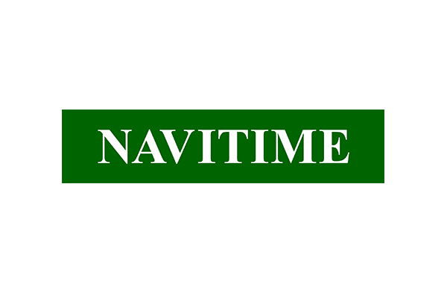




Put AI to work for your business
Personalize customer experiences with targeted recommendations
recommendation technology used by Amazon.com | context-aware recommendations sentiment analysis | VoC analytics
PERSONALIZE
REKOGNITION
IMAGE
REKOGNITION
VIDEO
COMPREHEND
Notes:
Why personalize?
Machine learning is being increasingly used to improve customer engagement by powering personalized product and content recommendations, tailored search results, and targeted marketing promotions.
However, developing the machine-learning capabilities necessary to produce these sophisticated recommendation systems has been beyond the reach of most organizations today due to the complexity of developing machine learning functionality.
Epsilon research indicates 80% of consumers are more likely to make a purchase when brands offer personalized experiences: http://pressroom.epsilon.com/new-epsilon-research-indicates-80-of-consumers-are-more-likely-to-make-a-purchase-when-brands-offer-personalized-experiences/
By 2018, companies that have “fully invested in all types of personalization” will outsell companies that have not by 20 percent. https://contently.com/2017/03/31/personalization-changing-content-marketing/
Why Amazon Personalize?
Amazon Personalize is a machine learning service that makes it easy for developers to create individualized recommendations for customers using their applications.
It allows developers with no prior machine learning experience to easily build sophisticated personalization capabilities into their applications, using machine learning technology perfected from years of use on Amazon.com.
Customer examples:
Domino's Pizza Enterprises Ltd (DPE) is one of the largest pizza businesses in the world; their vision is to be the leader in deliveries in every neighborhood. "The customer is at the heart of everything we do at Domino's and we are working relentlessly to improve and enhance their experience. Using Amazon Personalize, we are able to achieve personalization at scale across our entire customer base, which was previously impossible. Amazon Personalize enables us to apply context about individual customers and their circumstances, and deliver customized communications such as special deals and offers through our digital channels."Mallika Krishnamurthy, Global Head, Strategy & Insights - Domino's Pizza Enterprises
Zola.com is the fastest growing wedding company in the country using design and technology to create the easiest wedding planning and registry experience for couples getting married today. "At Zola, we develop innovative wedding planning tools to serve couples. We want to be there along the entire wedding journey and provide the best possible recommendations to our customers based on their style, interests, or preferences. Until now, those recommendations have been implemented via rule-based ranking, popularity, or, more recently, via a similarity model calculated offline. These methods were difficult to maintain and scale. Amazon Personalize provides us with state-of-the-art algorithms and an end-to-end personalization solution that enables us to respond to customer actions in real-time. Being a small team, using Amazon Personalize will allow us to quickly deliver solutions that would have otherwise taken a much larger team and several months development time."Stephane Bailliez, VP of Engineering - Zola.com
RBmedia is a global leader in spoken audio content and digital media distribution technology that reaches millions of consumers. "Our customers are far more likely to engage with personalized content recommendations that are tailored to them and their particular needs, especially when they're given hundreds of thousands of titles to choose from. Amazon Personalize made it easy to build, train and deploy a personalization system at scale, without the need of utilizing extensive resources and specialized expertise."Mike Pyland, CTO - RBmedia
Spuul is an Over-the-top (OTT) platform delivering Indian Movies and TV Shows to an audience worldwide. "With thousands of movies and TV shows selection, it is a challenge to surface the most relevant programs to our viewers. To enable faster and more efficient content discovery, we want to deliver the highest quality content recommendations that are tailored to individuals' interests and preferences. Amazon Personalize enables us to easily and quickly implement a recommendation engine. Despite having no prior experience in AI/ML, it only took us 3 days to understand the service, create a first data set, and generate a recommendation. With Amazon Personalize, we will be able to provide every consumer with a personalized viewing experience."Daniel Muller, Head of Cloud Infrastructure – Spuul
NAVITIME is the leading provider of navigation technology and services in Japan. "NAVITIME is committed to delivering the most pertinent and up-to-date travel information for all our users. Beyond just getting users from one spot to the next, NAVITIME takes into consideration their previous trips and traveling preferences, and use that information to offer personalized experiences and discover businesses around them. We believe that Concierge offers an efficient solution that will help us drive relevant, contextual recommendations, and further improve our overall user experience."Ikuo Odanaka, General Manager of Development Department - NAVITIME

Slide 80

Personalizing
customer experiences
Domino’s uses Amazon Personalize to customize and scale relevant marketing communications to customers based on time, context, and content, thereby improving and enhancing their experience with the Domino’s brand.
Notes:
Domino's Pizza Enterprises Ltd (DPE) is one of the largest pizza businesses in the world; their vision is to be the leader in deliveries in every neighborhood. "The customer is at the heart of everything we do at Domino's and we are working relentlessly to improve and enhance their experience. Using Amazon Personalize, we are able to achieve personalization at scale across our entire customer base, which was previously impossible. Amazon Personalize enables us to apply context about individual customers and their circumstances, and deliver customized communications such as special deals and offers through our digital channels."Mallika Krishnamurthy, Global Head, Strategy & Insights - Domino's Pizza Enterprises

Slide 81



Put AI to work for your business
Accurately forecast future business outcomes
forecasting technology used by Amazon.com | multiple time-series data
forecast scheduling & visualization | supply chain integration
FORECAST
Notes:
Why forecasting?
Companies today use everything from simple spreadsheets to complex financial planning software to attempt to accurately forecast future business outcomes such as product demand, resource needs, or financial performance.
These tools build forecasts by looking at a historical series of data, which is called time series data. For example, such tools may try to predict the future sales of a raincoat by looking only at its previous sales data with the underlying assumption that the future is determined by the past.
This approach can struggle to produce accurate forecasts for large sets of data that have irregular trends. Also, it fails to easily combine data series that change over time (such as price, discounts, web traffic, and number of employees) with relevant independent variables like product features and store locations.
Amazon Forecast?
Amazon Forecast is a fully-managed service that uses machine learning to deliver highly-accurate accurate forecasts.
Based on the same technology used at Amazon.com, Amazon Forecast uses machine learning to combine time series data with additional variables to build forecasts.
You only need to provide historical data, plus any additional data that you believe may impact your forecasts. Amazon Forecast will automatically identify what is meaningful, and produce a forecasting model capable of making predictions that are up to 50% more accurate than looking at time series data alone.
Forecast works very much the same way that Personalize does. You actually start streaming historical data into us, all kinds of information on supply chain and inventory levels. You'll give us all the possible variables that could impact the forecast, what we call “causals.” Then Forecast uses the same algorithms that we've built to do forecasting on Amazon over the last 20 years and gives you time series forecast out of an API on the other end. What's happening behind the scenes, again, is very similar, where we do the analytics and we look for the signal. We actually will then choose from eight proprietary algorithms that we've built to do our forecasts over the years.
Customer examples:
CJ Logistics is the leading logistics company in South Korea.
Amazon Forecast has been applied to CJ Logistics’ parcel volume forecasting process to optimize the amount of human resources, transportation, and warehouse space we provision to meet demand. Amazon Forecast allows us to use sophisticated machine learning-based forecasting techniques without building our own system. Looking forward, we have a clear vision of increasing our operational efficiency by using Amazon Forecast. - YoungSoo Kim, Vice President of TES Strategy Unit, CJ Logistics
Mercado Libre
“We have been using Amazon Forecast to predict demand for over 50,000 different products, using Amazon Forecast’s state-of-the-art deep learning algorithms that we can use right out of the box. Amazon Forecast takes care of all the heavy lifting of setting up pipelines, re-training schedules, and re-generating forecasts, so we can experiment with hundreds of models very easily.”

Slide 82


Put AI to work for your business
Increase efficiency with automated document analysis
optical character recognition (OCR) | automatic data extraction | natural language processing intelligent search | text analytics
TEXTRACT
COMPREHEND &
COMPREHEND MEDICAL
Notes:
Why document analysis?
Dealing with documents is actually painful. If you think about it, what most people do is one of a few things, and they all have issues. Either, again, they try to use thousands of humans who sit with these documents at a terminal and type everything in. That's obviously slow and expensive and doesn't get you nearly the amount of documents you want. Some people use OCR, but the problem with OCR is it's kind of a dumb protocol. It takes all the language and it just kind of takes it as it comes.
Sometimes you get text that you can use in a digital format, and sometimes you don't. Or sometimes people build templates for certain forms. The problem is there is an endless number of these forms, and the forms themselves change every few years. They're very rigid and very fragile. And so our customers are frustrated that they can't get more of all this text and data that are in documents into the cloud so that they can actually do machine learning on top of it.
So working with our customers, we thought about what might solve these problems.
Why Amazon Textract?
Amazon Textract is a service that automatically detects and extracts text and data from scanned documents. It goes beyond simple optical character recognition (OCR) to also identify the contents of fields in forms and information stored in tables.
Textract overcomes traditional challenges by using machine learning to instantly “read” virtually any type of document to accurately extract text and data without the need for any manual effort or custom code.
You can quickly automate document workflows, enabling you to process a million document pages in one hour.
Once the information is captured, you can take action on it within your business applications, create smart search indexes, build automated approval workflows, and better maintain compliance with document archival rules.
“At Alfresco, we want to make document processing and content management as simple as possible for our customers. Since a document management system is only as good as its input, it is critical that we have the foundational tools that can automatically and accurately extract key information from digitized documents. Previously, we built custom solutions on top of OCR technology in order to extract data of interest, which required intensive manual training. This process consumed valuable time and resources, but it was work that had to be done. With Amazon Hieroglyph, we can now automatically extract not just the text in a document and table information, but real insights that allow us to automate data entry and facilitate faster business decisions. Hieroglyph is enabling us to provide greater data integrity, security compliance, and the ability to launch business processes faster than ever. And most importantly, all of this helps us better assist our customers in their digital transformation journey.” - John Newton, CTO & Founder, Alfresco
“At Cox Automotive, we are looking to transform the way the world buys, sells, owns and uses cars. To further modernize our automotive solutions, we will be leveraging Amazon Hieroglyph to accelerate how quickly cars can be transacted. With Hieroglyph, we can automatically capture and validate data from documents and forms, such as loan applications or vehicle titles, so decisions can be made more quickly. This will reduce customer effort and further streamline the process for everyone involved from the manufacturer to the buyer.” - Bryan Landerman, Chief Technology Officer at Cox Automotive

